Slide 1
Question 1
To synchronize a clock within ± 1 ms it is necessary to obtain a round-trip time of no more than 18 ms, given
the minimum message transmission time of 8 ms. In principle it is of course possible to obtain such a roundtrip time, but it may be improbable that such a time could be found. The file server risks failing to synchronize over a long period, when it could synchronize with a lower accuracy.

Slide 2
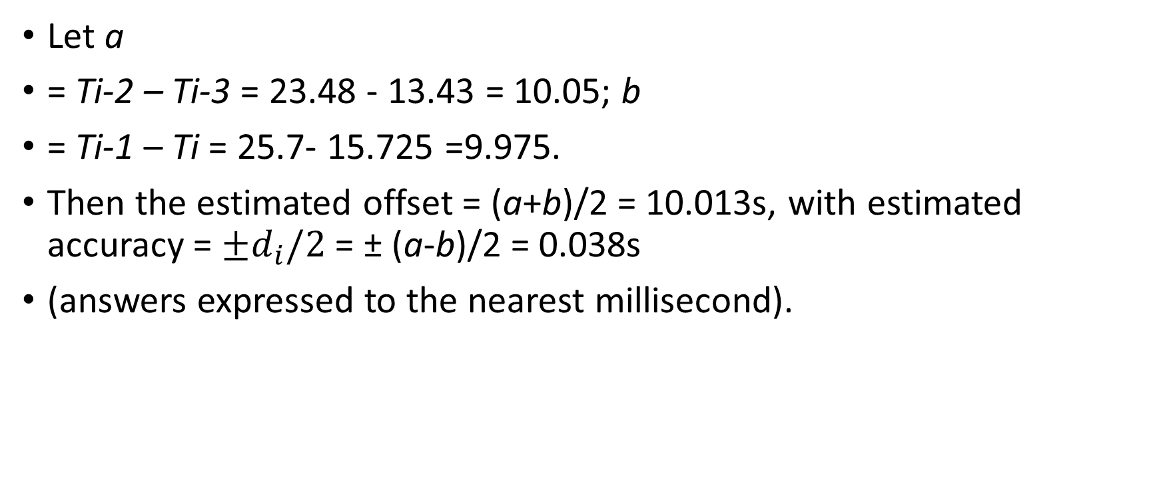
Question 2
Let a
= Ti-2 – Ti-3 = 23.48 - 13.43 = 10.05; b
= Ti-1 – Ti = 25.7- 15.725 =9.975.
Then the estimated offset = (a+b)/2 = 10.013s, with estimated accuracy = ${±d}_{i}/2$ = ± (a-b)/2 = 0.038s
(answers expressed to the nearest millisecond).

Slide 3
Question 3
The main factors to take into account are the intrinsic reliability of the server as a source of time values, and the quality of the time information as it arrives at the destination. Sanity checks are needed, in case servers
have bugs or are operated maliciously and emit spurious time values. Assuming that servers emit the best time values known to them, servers with lower stratum numbers are closest to UTC, and therefore liable to be the
most accurate. On the other hand, a large network distance from a source can introduce large variations in network delays. The choice involves a trade-off between these two factors, and servers may synchronize with several other servers (peers) to seek the highest quality data.

Slide 4

Question 4
If e and $e^{′}$ are successive events occurring at the same process, or if there is a message m such that e = send(m) and $e^{′}$= rcv(m), then the result is immediate from LC1 and LC2. Assume that the result to be proved is true for all pairs of events connected in a sequence of events (in which either HB1 or HB2 applies between each neighbouring pair) of length N or less (N ≥ 2). Now assume that e and are connected in a series of events e1, e2, e3, .., eN+1 occurring at one or more processes such that e = e1 and $e^{′}$= eN+1. Then e→ eN and so C(e)< C(eN) by the induction hypothesis. But by LC1 and LC2, C(eN) <C($e^{′}$). Therefore C(e) < C($e^{′}$ ).

Slide 5
Question 5
If we know that the drift rate is constant, then we need only measure it between synchronization points with an accurate source and compensate for it. For example, if the clock loses a second every hour, then we can add a second every hour, in smooth increments, to the value returned to the user. The difficulty is that the clock’s drift rate is liable to be variable – for example, it may be a function of temperature. Therefore we need an adaptive adjustment method, which guesses the drift rate, based on past behaviour, but which compensates when the drift rate is discovered to have changed by the next synchronisation point.

